Slide 3
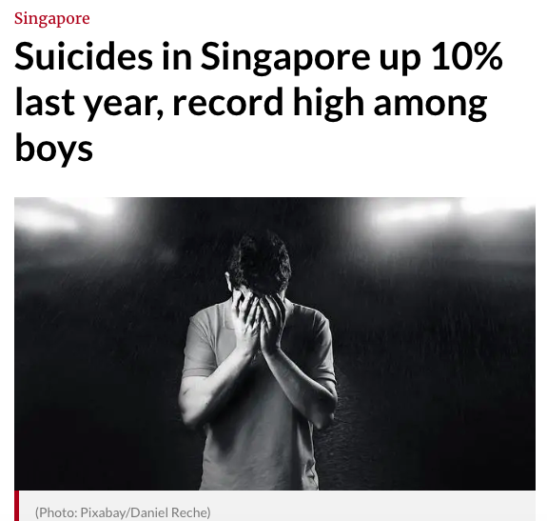

Slide 4
depression
&
Suicide
...suicidal ideation, in the absence of another diagnosis, is quintessentially associated with major clinical depression.
Yet, most depressed patients do not die by suicide ,and many of them never experience suicidal ideation even in the most severe depressing scenario.
Annals of General Psychiatry

Slide 5
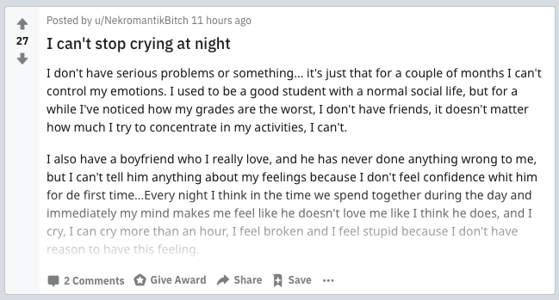
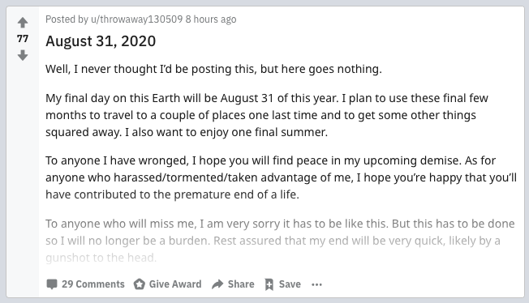
r/
depression
&
r/
SuicideWatch

Slide 6
Data Cleaning/ Preprocessing

Slide 7
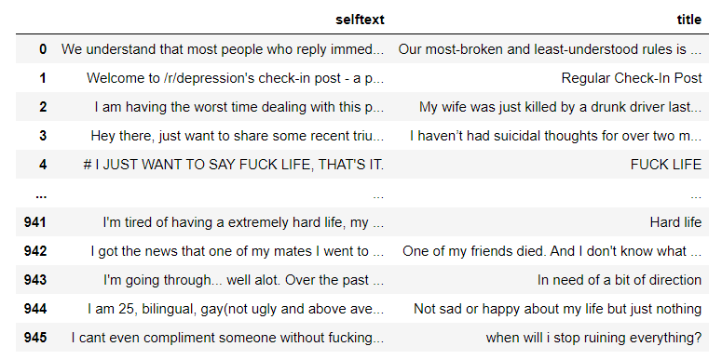
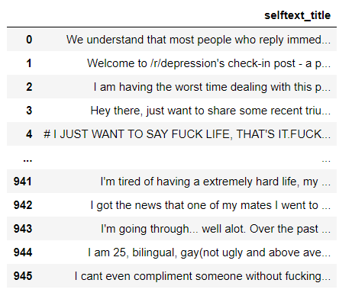
EMPTY
CELL

Slide 8
EMPTY
CELL
= “WHAT SHOULD I DO?”

Slide 9
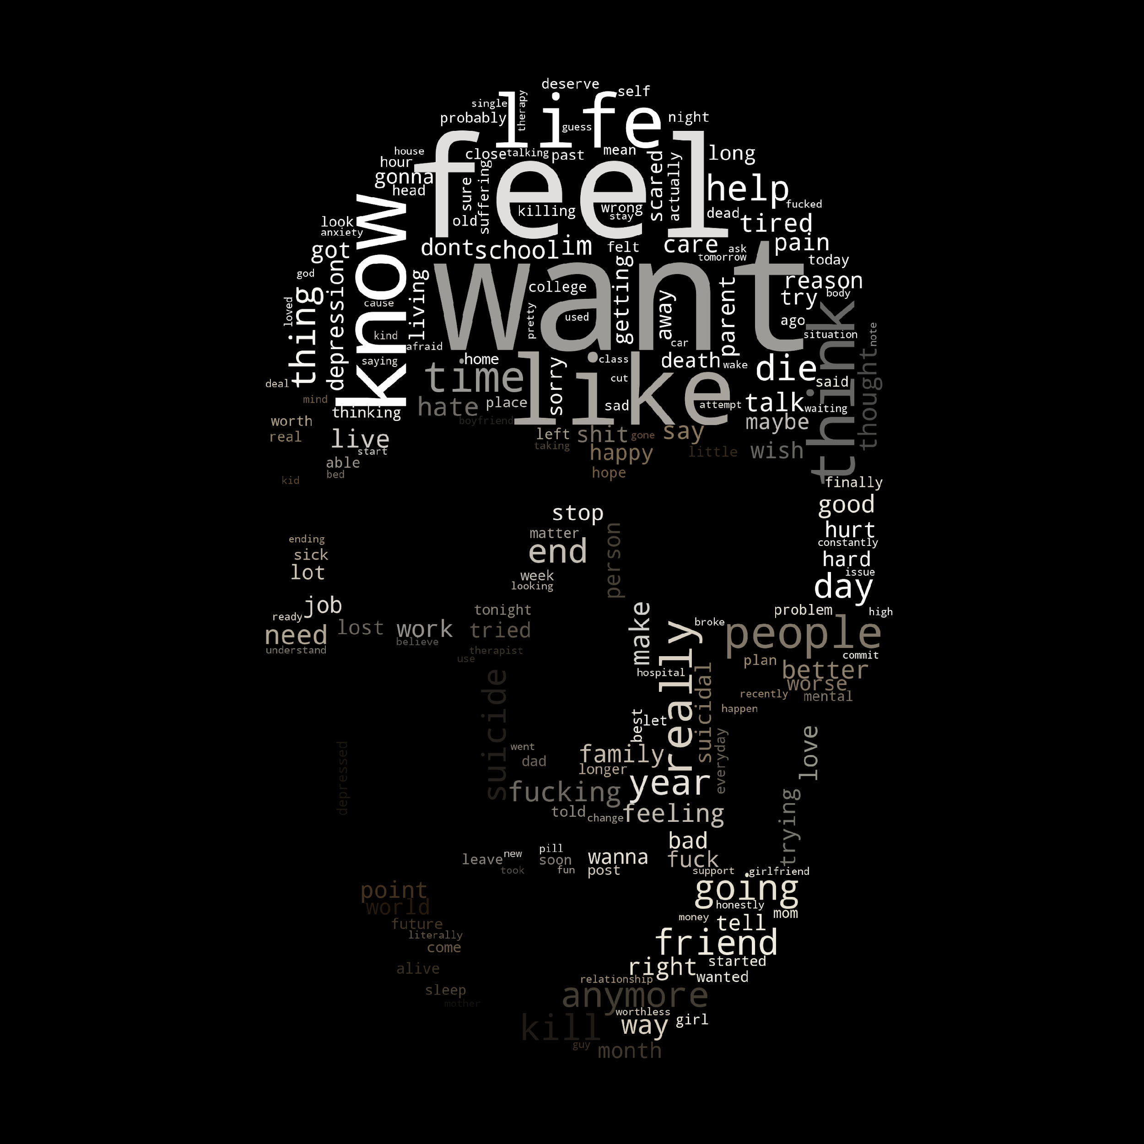
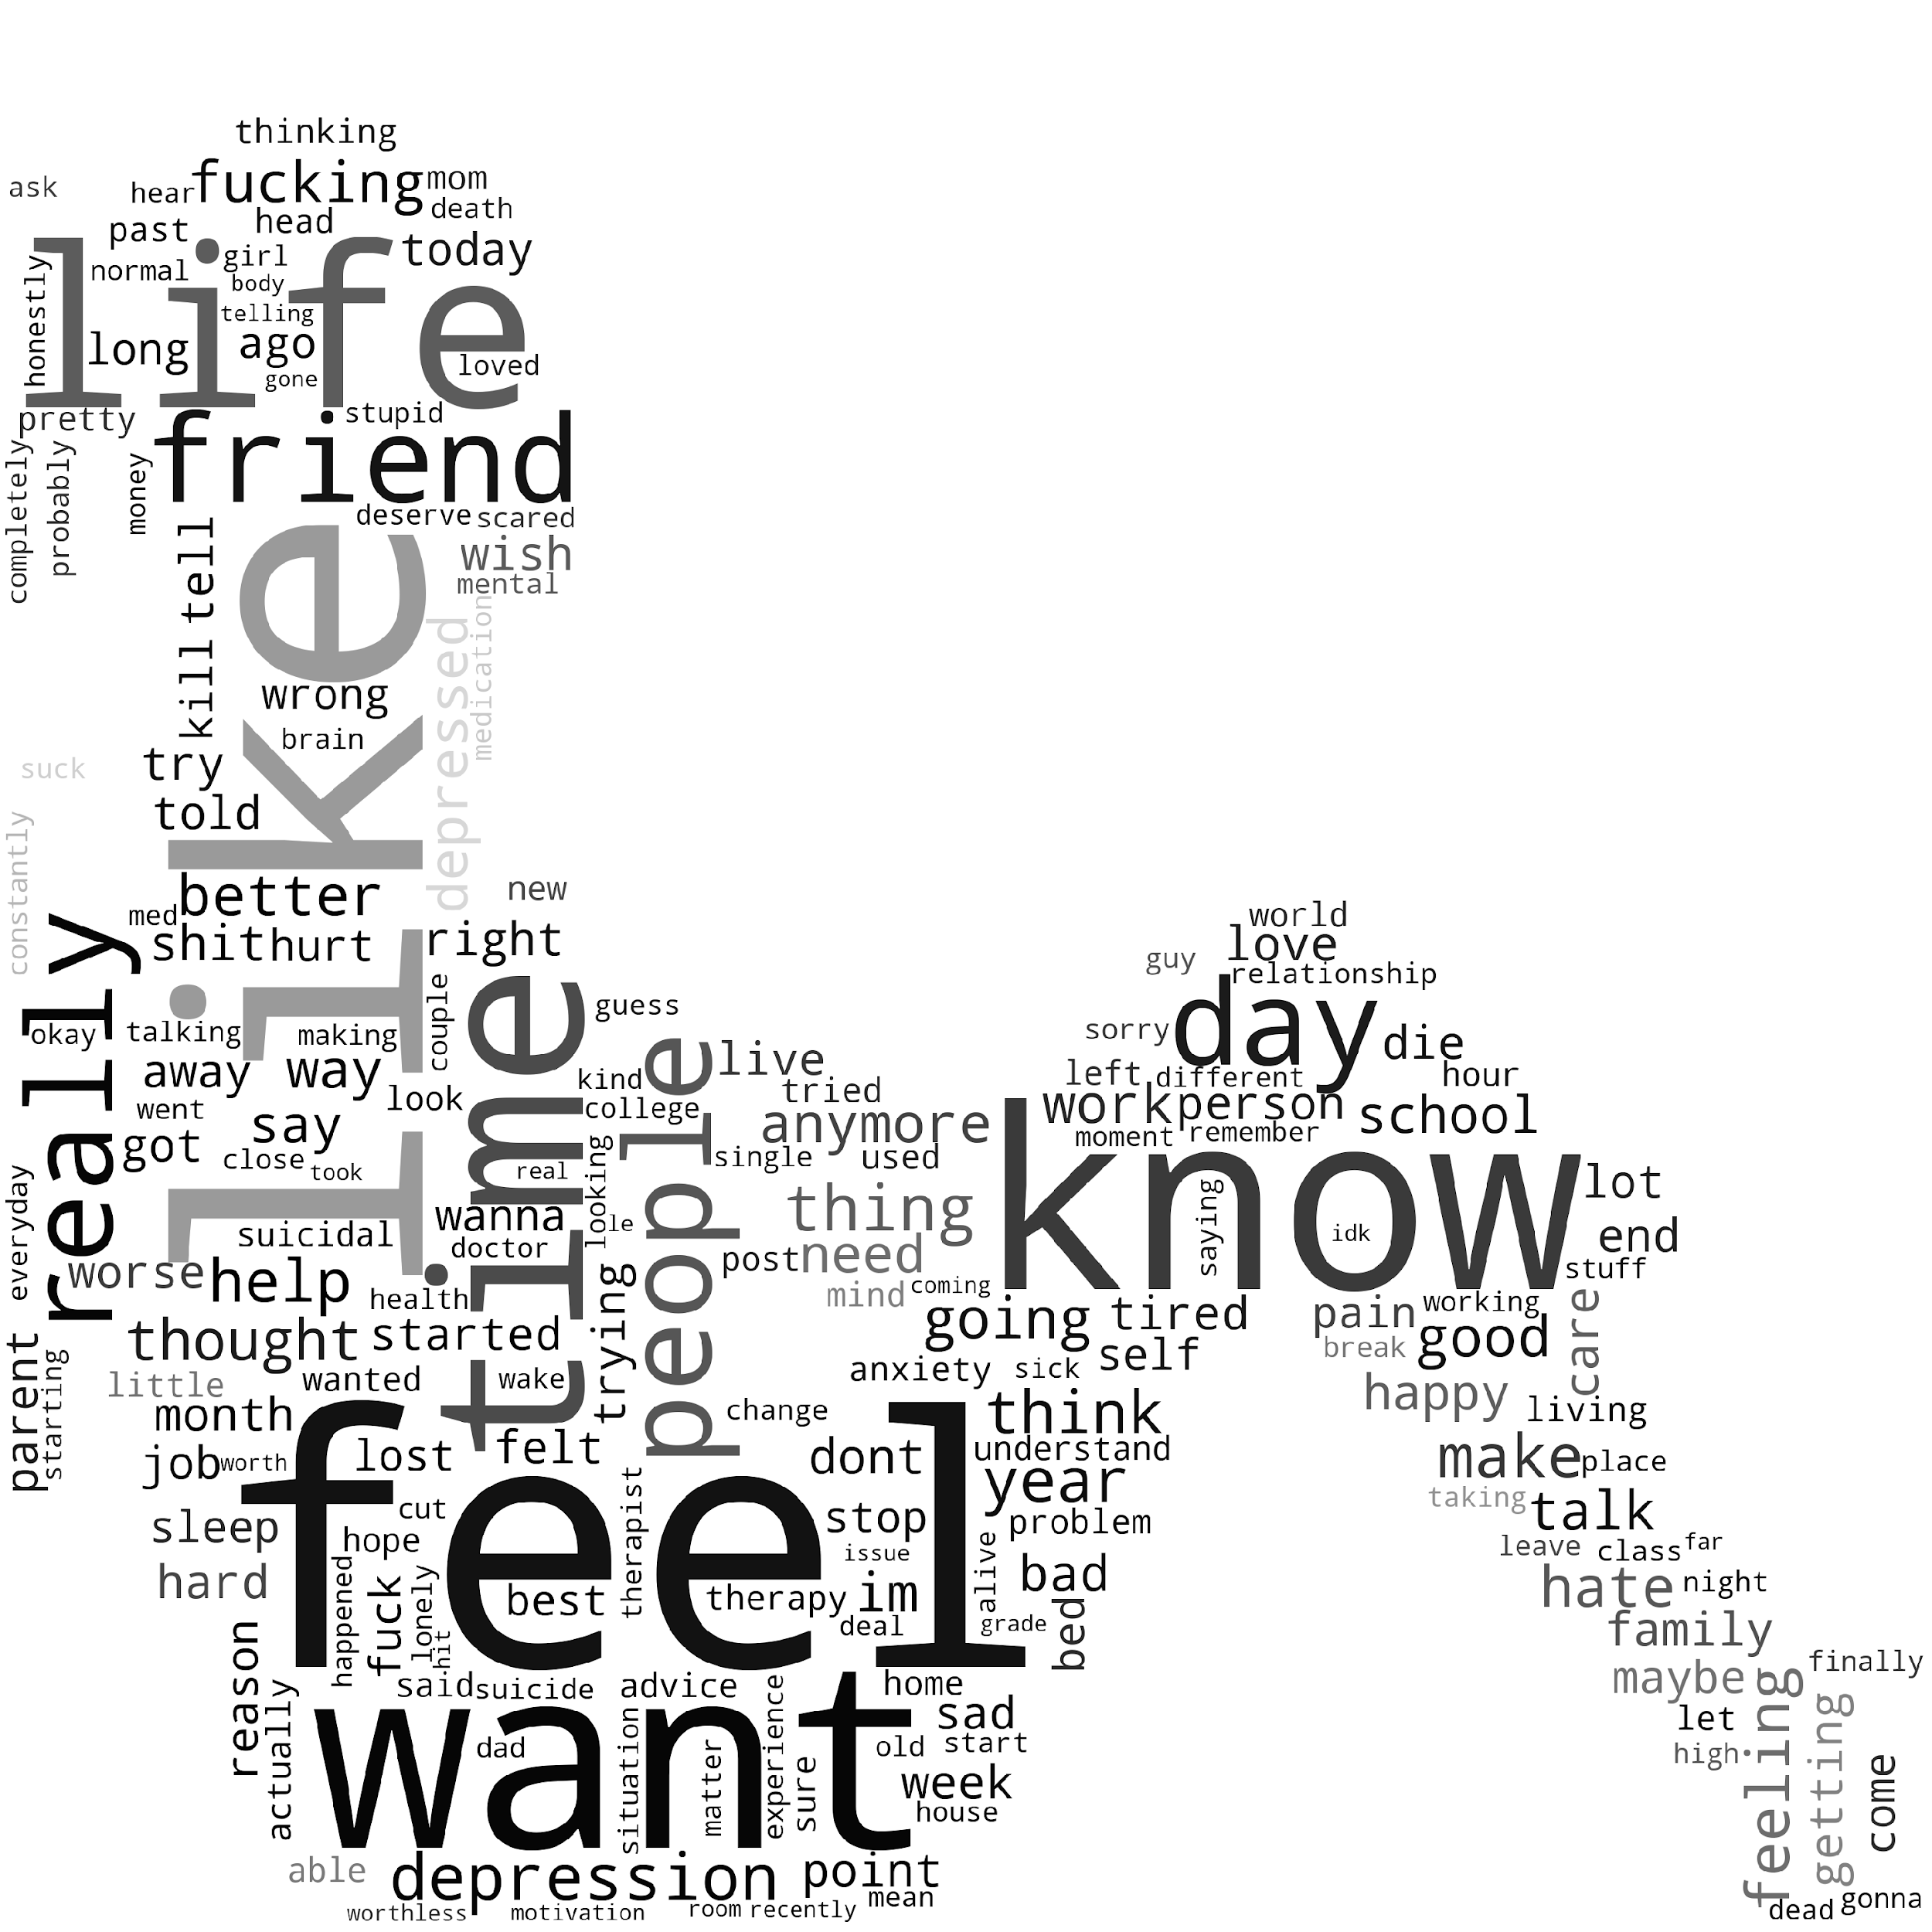

Slide 10
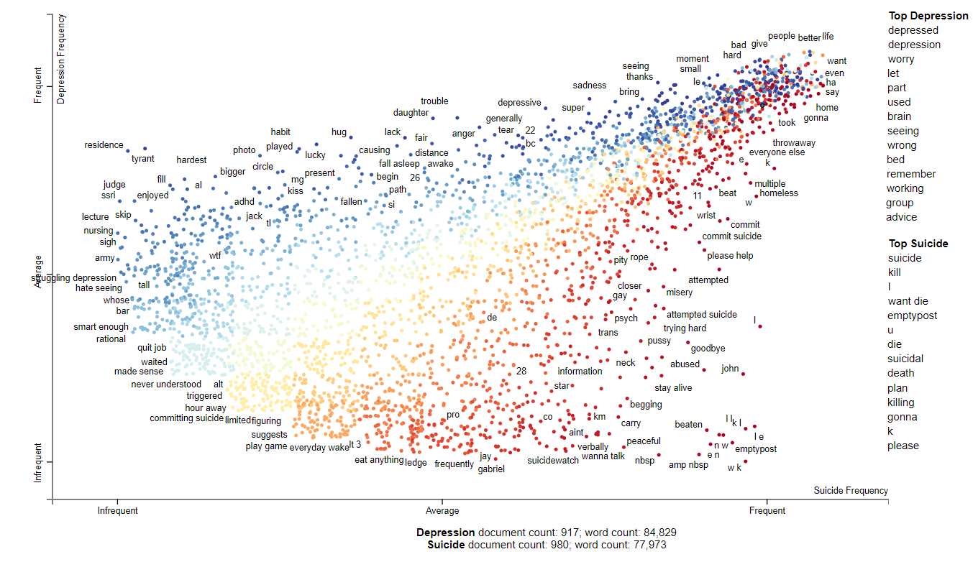
life
school
friend
help

Slide 11
Building a Model

Slide 12
Model predicts “suicide” correctly
TP
FN
TN
FN
Model predicts “depression” wrongly. It was actually “suicide.

Slide 13
TP
FN
TN
FN

Slide 14
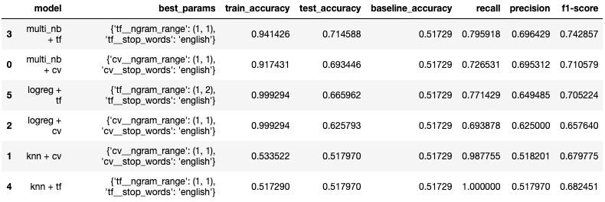
MODEL
SELECTION

Slide 15
MODEL
SELECTION

Slide 16

TF-IDF
MULTINOMIAL NAIVE BAYES
Comparison of models:
Naïve Bayes assumes all the features to be conditionally independent.
Logistic regression typically works reasonably well even when some of the variables are correlated.
Why Multinomial Naive Bayes then?
Best parameter for Tfidf Vectorizer: max_df = 0.45

Slide 17
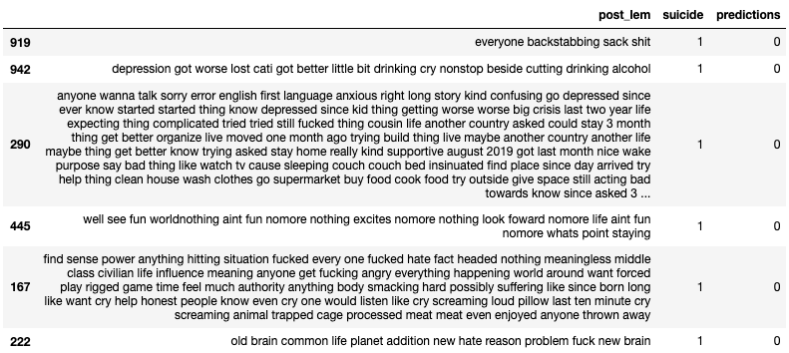
ANALYSING
FALSE NEGATIVES

Slide 18
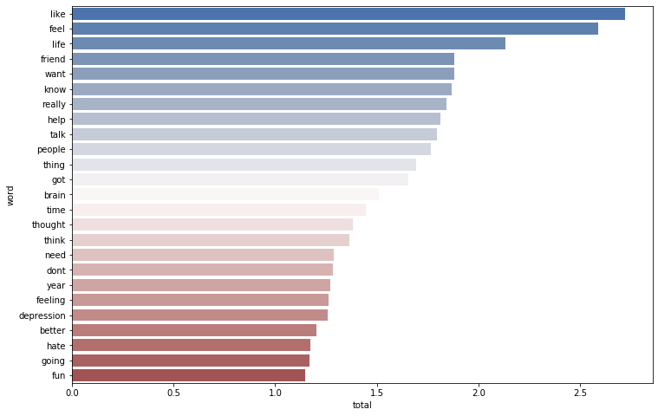
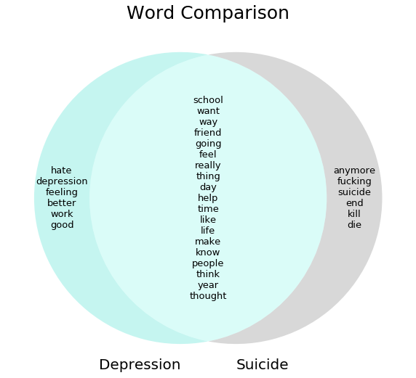

Slide 19
Victoria’s Diary

Slide 20
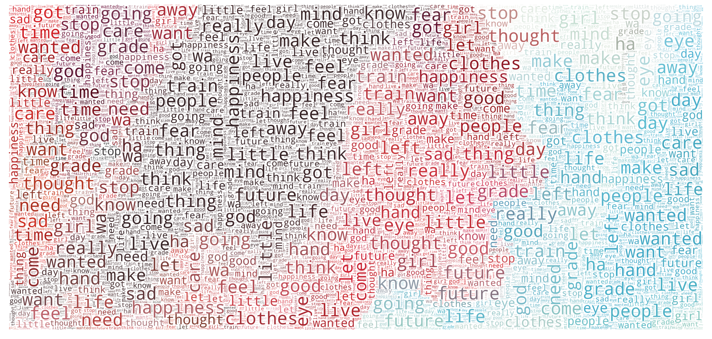

Slide 21
“I've known that I will never have a dazzling life...with the grades I get”
STAGE 1: FALLING SHORT OF EXPECTATIONS
“[During PE] I get to show my un-sportiness and unpopularity... the only people who are in it are popular high-achievers.”
STAGE 3: HIGH SELF-AWARENESS
“I got the lift to the top and wanted to just look down and see how high it was ....
Suddenly, I just ... wanted
to be dead.”
STAGE 6:
DISINHIBITION

Slide 22
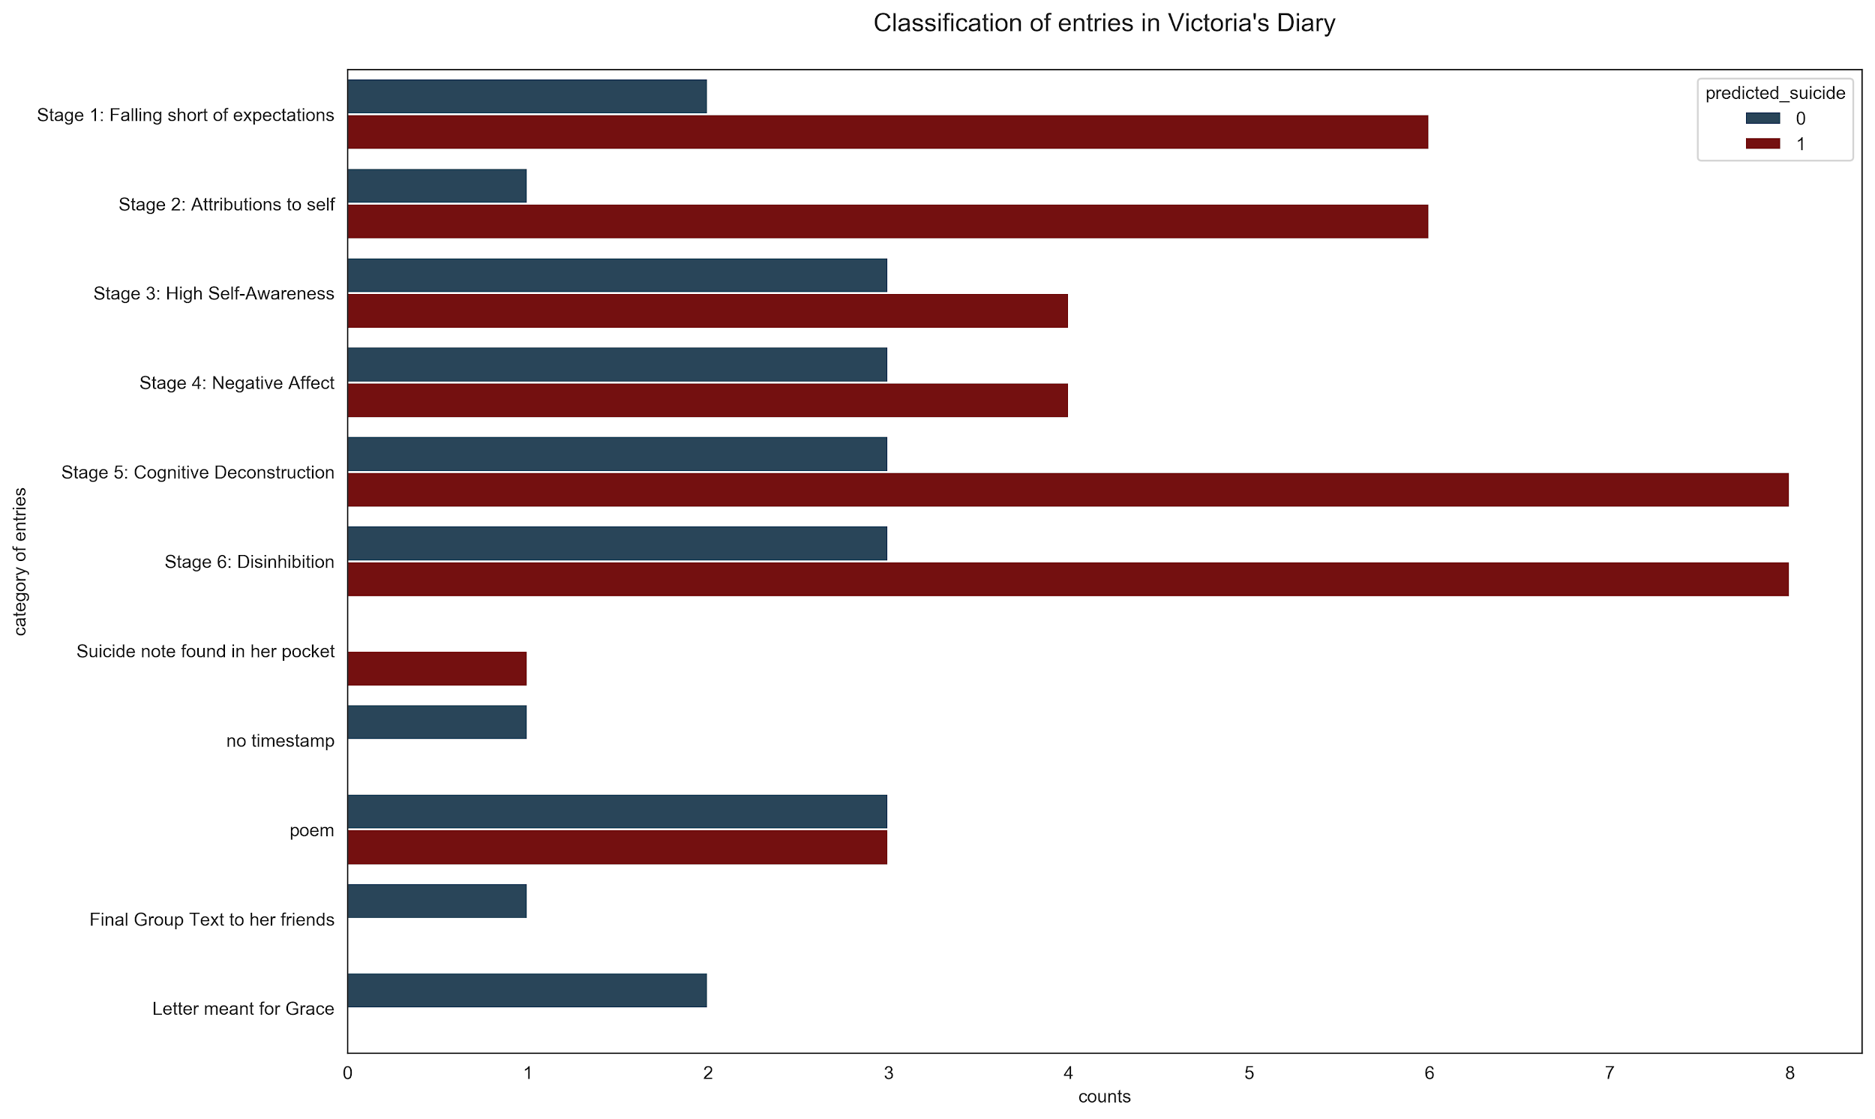

Slide 23
The End

Slide 24
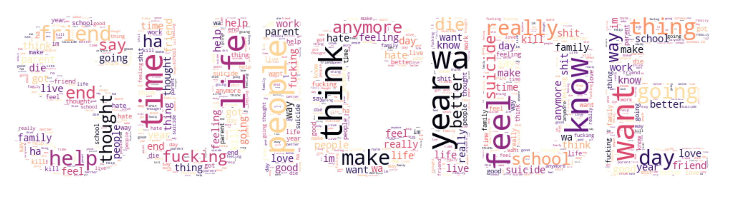
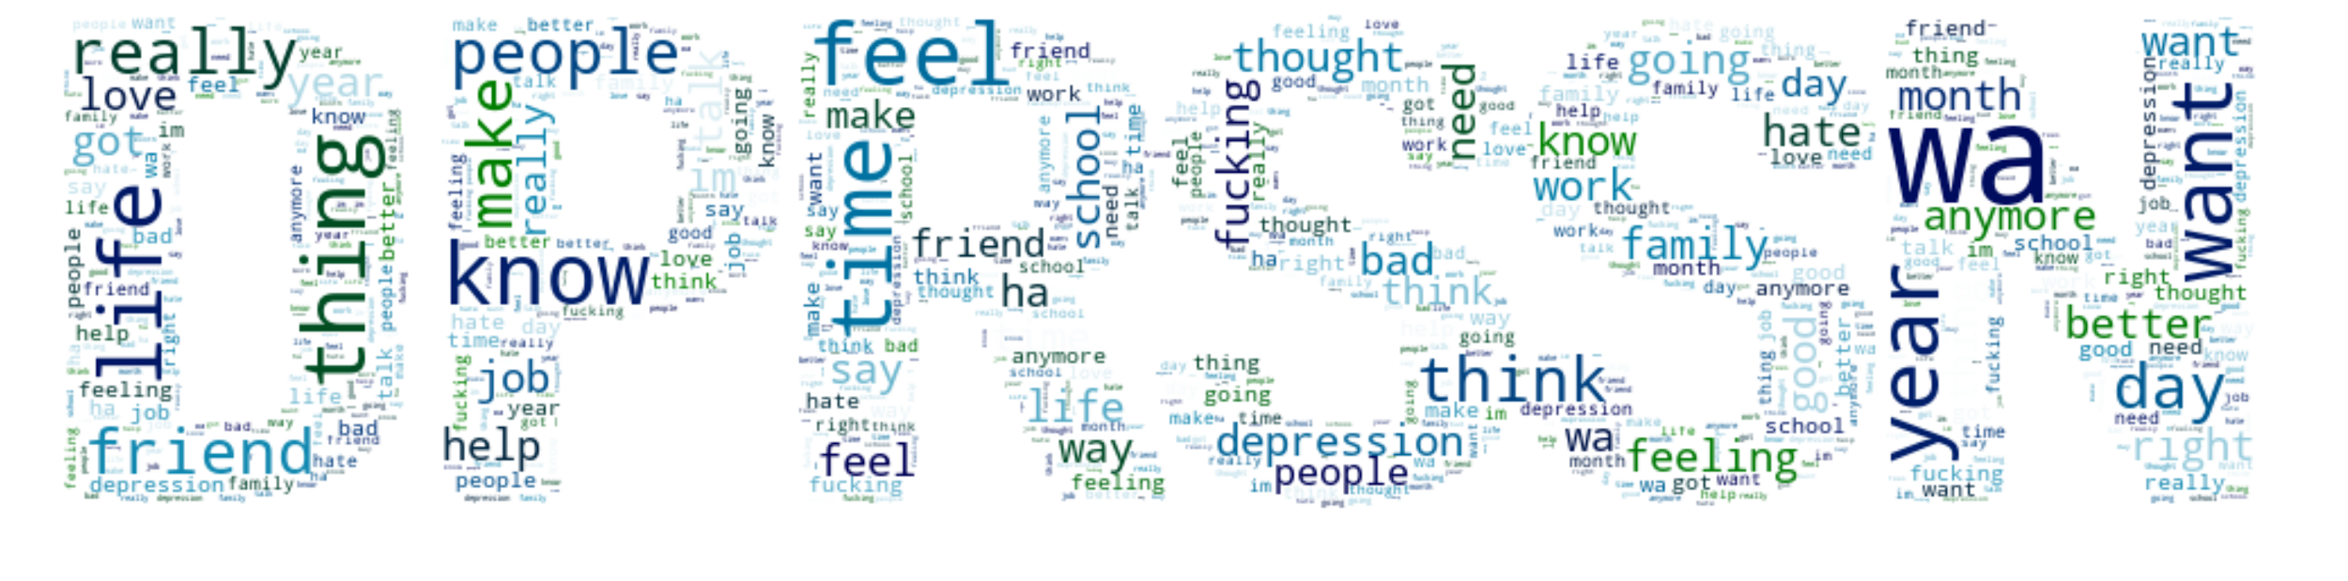

Slide 25
